Slide 1
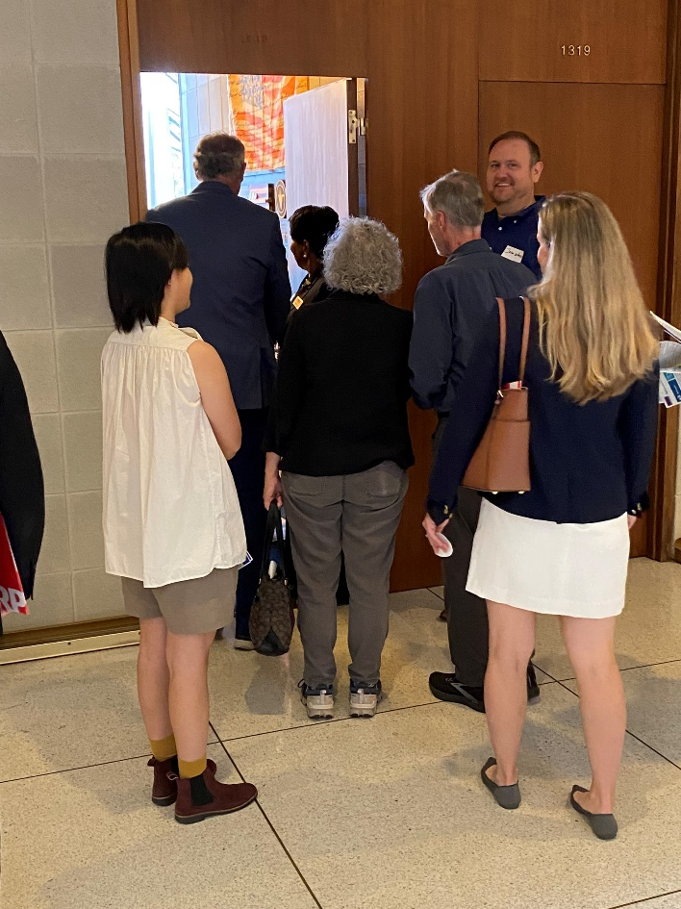

2025 Aging Advocacy Day Prep

Slide 2
The Reminder
AARP is a nonprofit, nonpartisan organization that doesn’t endorse
candidates or make contributions to political campaigns, parties, or
candidates—ever. Our members and employees join us from across
the political spectrum, and AARP has a long record of making sure
that elected officials from both parties address the issues that matter
to all Americans age 50-plus.
To reinforce our nonpartisan stance, AARP engages on our issues
with an eye for avoiding any appearance of favoritism. Our
legislative advocacy and voter education work is issue-focused, not
party or person-focused, and we gladly work with all who stand with
us on our key priorities.

Slide 3
Advocacy vs. Lobbying
Advocacy is the act or process of supporting a cause or proposal.
An advocate is someone
who speaks on behalf of a cause or proposal. The advocate may be an individual or an organization.

Slide 4
Advocacy vs. Lobbying
Lobbyist: An individual who engages in direct lobbying or goodwill lobbying on behalf of an organization who is compensated for lobbying.
Nonprofit volunteers aren’t required to register.

Slide 5
What Influences a Legislator?
The following are some of the considerations legislators have when thinking about legislation.
How large is the problem and does it have a practical solution?
What impact does it have on his/her district?
What is the cost?
What organizations, individuals, businesses care about this issue? Do constituents care?
What is the media saying?
Does the issue affect me personally?
What do my constituents say?
Will this help me get re-elected? How does this affect my fundraising?
What do opponents say? Why? How strong is the opposition?

Slide 6
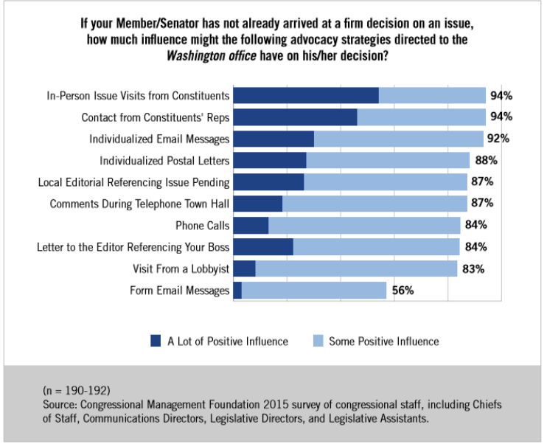

Slide 7
Advocacy 101
The Power of Your Story
Personal Stories are the most compelling form of advocacy!

Slide 8
Guidelines for Meeting
Lobbying is about:
Showing a united network of supporters
Building a relationship with lawmakers
It’s LESS about the details of any one bill.
Therefore:
Don’t sweat the small stuff
Look for opportunities to gauge their support
Find common ground in their personal lives (did you attend same school? Do you have family/friends/neighbor that knows them?)
Cartlon Reid
Roads were not made for cars

Slide 9
What if…
IF you are asked a question and you can’t answer.
“I don’t know. Let me find out and get back to you on that.”
Make sure to follow up.
IF you don’t get an answer.
“I appreciate that you’ll need to learn more. How can I help?”
“Will you check in with the Representative and let me know?”
“When should I follow up with you?”

Slide 10
Biggest FRUSTRATIONS
Meeting ends before you get to make the ask.
  Have team prepared to do short introductions
  Be prepared to take initiative and make the “ask”
You make the case but leave not knowing the Representatives’ position
  Be prepared to listen! Listening can be more important than making your case

Slide 11
Follow up (Please!)
Short term goal:
  Get an answer: do they support issue you went there to advocate for?
  Phone, letter, or email learn your legislators preferred mode of communication
Medium-Long Term Goal
  Continue that relationship
  Clarify any questions you have
  Answer any questions they had
  Make the ask again

Slide 12
Relationship Development: Keep it Going
Stay in contact – Become a resource
Visit them in the district or send email, phone call, etc.
Once every month or so
Keep them abreast of local progress
    Events
    State or local policy alerts

Slide 13
What if it’s only the “Staffer”?
Staffers are key!
If member is not available ask if LA has a few minutes
Staffers can influence legislator and relay information
Staffers understand the issues (often know more details than the member)

Slide 14
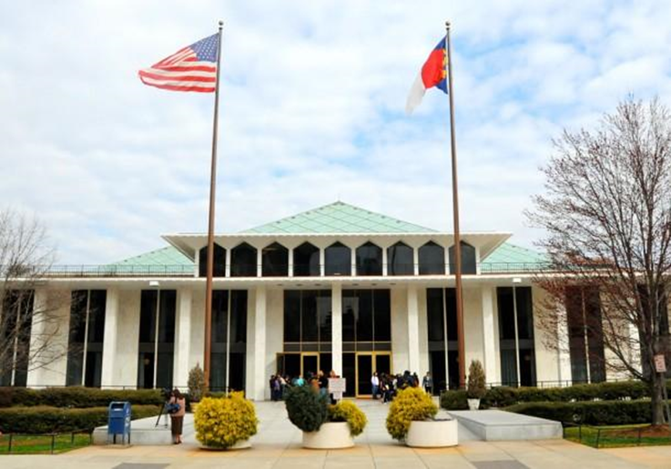

NC General Assembly or
“The Legislature”
“Bicameral” legislature — meaning that it’s made up of two bodies:
  the House of Representatives, which has 120 members, and
  the Senate, which has 50 members.
  Elections are held every two years for each member of the General Assembly.
Notes:
Numbers are important to keep in mind when thinking of passing bills
Election every other year means our legislature is often in election mode – half the time!

Slide 15

Advocacy at the NC State Legislature
Two Year/ Biennium Sessions
Legislative Long Session began January 2025
End of Long Session: June 27 – according to House calendar
Short session: May-June of 2026 primarily for budget tweaks

Slide 16
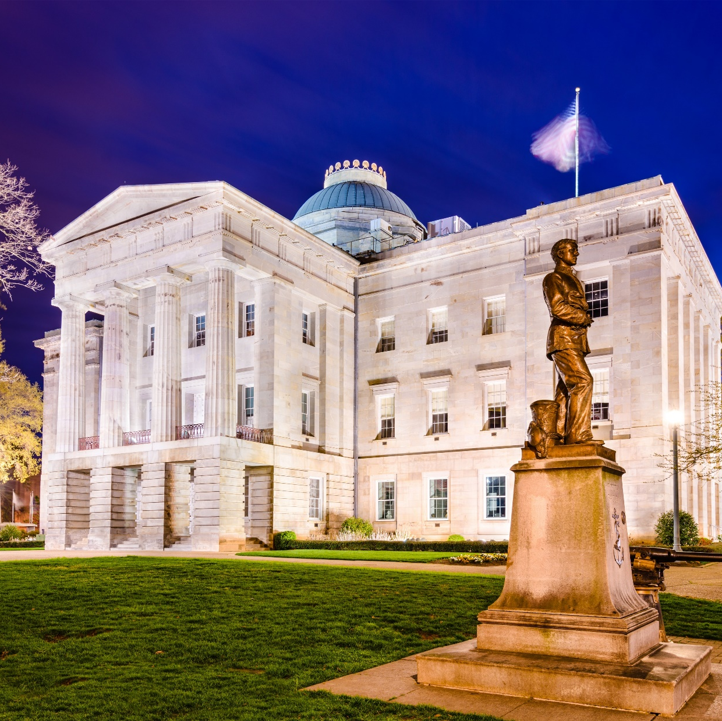
2025 Political Landscape
SENATE: GOP supermajority
HOUSE: GOP majority (1 vote shy of super)
Newly elected Democratic Governor Josh Stein

Slide 17
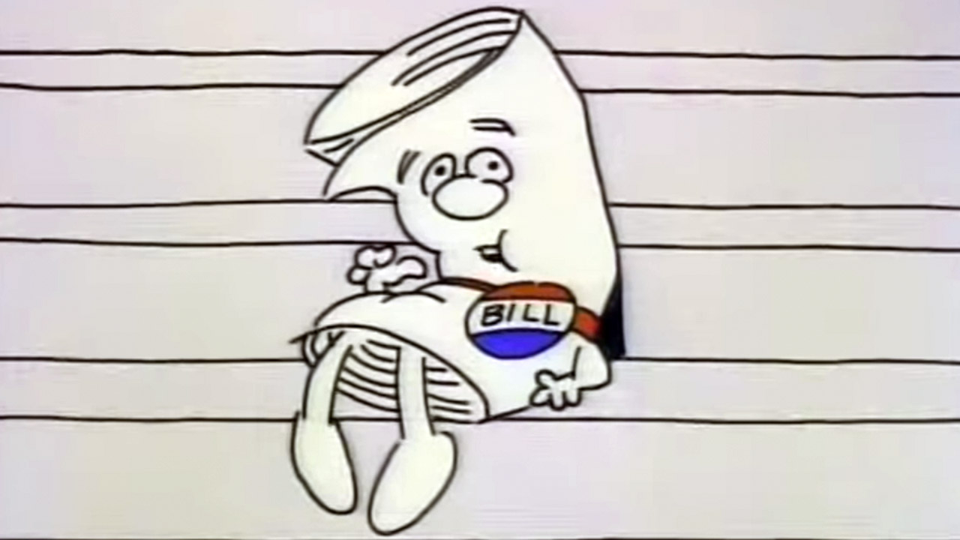
How a Bill Becomes a Law in North Carolina
Drafting of Bills
Introduction of Bills
Reference to Committee
Notes:
Bills can be drafted by any “competent” person, most likely working within the General Assembly. However, a legislator must turn in any drafted legislation to one of two different offices for consideration.
A member of the General Assembly must introduce the bill. If the bill is being “introduced,” it means that it has already been filed with the Principal Clerk on the previous work day, at which time it received a bill number. When the Reading Clerk reads aloud the name and number, the bill has passed its first reading.
The appropriate committee will study the bill and recommend what happens next. If approved, the bill is placed on the calendar for consideration by the entire House or Senate. Amendments can be added both in committee and when it comes up for debate on the floor.

Slide 18
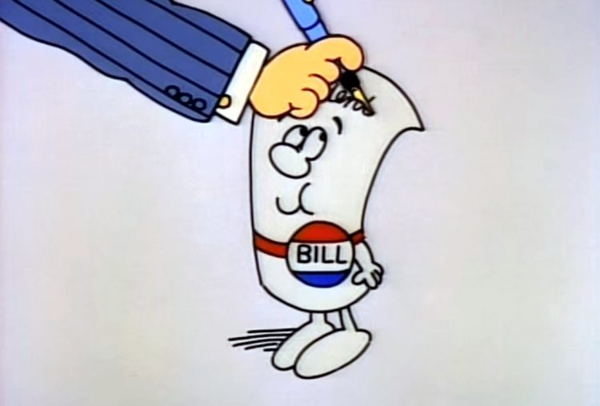
How a Bill Becomes a Law in North Carolina Continued..
Consideration by First Chamber
Consideration by Second Chamber
Enrollment, Ratification and Publication
For more in depth visual: https://www.ncleg.gov/Files/EducationalResources/HowAnIdeaBecomesALaw.pdf
Notes:
If the vote is favorable in the house in which the bill was introduced, it has passed its second reading and moves to its third and final reading.
After a bill passes its third reading in the house in which it was introduced, it is sent to the other house where it goes through the exact same process (referred to committee, etc.)
After a bill passes both houses, it is enrolled. The Governor may sign the bill into law or veto it. Both houses must have 3/5 vote to override the veto. Once it becomes a law, it is published.

Slide 20
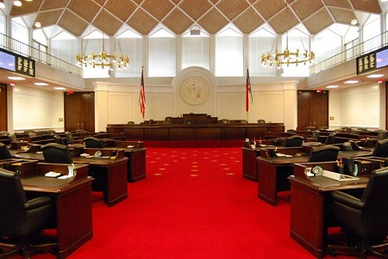

Importance of strategic sponsors and co-sponsors
Both chambers controlled by Republicans (one super majority, one simple majority)
Democratic Governor with some veto power
Ideally the sponsors would be
  Based on committees the bill be heard
Volunteers can help get Co-Sponsors in limited window (48 hour window)
Crossover May 8
Notes:
Successfully navigating a bill through both chambers of the NC State legislature is challenging and requires strategic thought about who the appropriate sponsors and co-sponsors of the bill are.
Sponsorship should be sought out based on what committees the bill will have to successfully pass out of before coming to the floor for a full vote and who sits on those committees.
Cover all Dem vs All Rep strategy
RULE 59. Cosponsorship of Bills and Resolutions, Removal of Sponsorship. – (a)
39 Except by leave of the primary sponsor, or as provided in subsection (d) of this rule, no member
40 may be listed as an additional primary sponsor on a bill after the bill has been filed. Except as
41 provided in subsection (d) of this rule, any member not listed as a preprinted cosponsor on the
42 computer-generated draft edition who wishes to cosponsor a bill or resolution which has been
43 introduced may do so by 5:00 P.M. of the calendar day following the adjournment of the session
44 during which such bill or resolution was first read and referred, but only electronically under
45 procedures approved by the Principal Clerk.
46 (b) Members wishing to cosponsor legislation prior to preparation of the draft
47 should indicate such to the drafter at the time the bill is requested and before filing the bill with
48 the Principal Clerk's office. The names of the members who are the primary sponsors shall be
49 listed in the order requested by them, followed by the words (Primary Sponsors); and the
50 remaining names of such members cosponsoring shall follow on the draft edition and first edition.
51 No more than four members may be listed as primary sponsors. Names of persons cosponsoring
General Assembly Of North Carolina Session 2019
Page 26 House Resolution 16
1 bills thereafter under subsection (a) of this rule do not appear on subsequent editions but shall be
2 listed in the bill status system as cosponsors

Slide 21
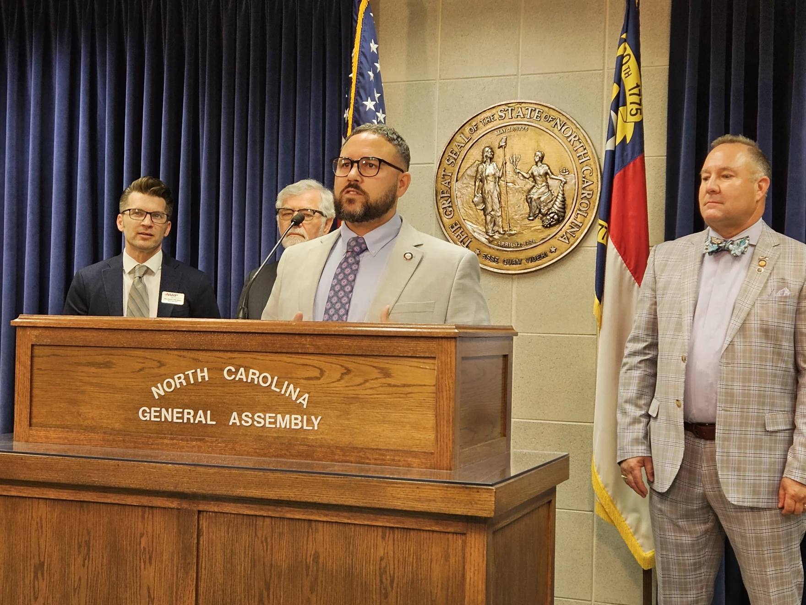
Advocacy Issues
Pass NC Work & Save (H79, S110)
Approve Property Tax Relief Study (H 432 passed House)
Continue State Funding for North Carolina Seniors’ Health Insurance Information Program (NC SHIIP)
Fully Fund the Medicaid Rebase
Provide Funding for NC Senior Games
Strengthening Long-Term Care Ombudsman Program
Notes:
Successfully navigating a bill through both chambers of the NC State legislature is challenging and requires strategic thought about who the appropriate sponsors and co-sponsors of the bill are.
Sponsorship should be sought out based on what committees the bill will have to successfully pass out of before coming to the floor for a full vote and who sits on those committees.
Cover all Dem vs All Rep strategy
RULE 59. Cosponsorship of Bills and Resolutions, Removal of Sponsorship. – (a)
39 Except by leave of the primary sponsor, or as provided in subsection (d) of this rule, no member
40 may be listed as an additional primary sponsor on a bill after the bill has been filed. Except as
41 provided in subsection (d) of this rule, any member not listed as a preprinted cosponsor on the
42 computer-generated draft edition who wishes to cosponsor a bill or resolution which has been
43 introduced may do so by 5:00 P.M. of the calendar day following the adjournment of the session
44 during which such bill or resolution was first read and referred, but only electronically under
45 procedures approved by the Principal Clerk.
46 (b) Members wishing to cosponsor legislation prior to preparation of the draft
47 should indicate such to the drafter at the time the bill is requested and before filing the bill with
48 the Principal Clerk's office. The names of the members who are the primary sponsors shall be
49 listed in the order requested by them, followed by the words (Primary Sponsors); and the
50 remaining names of such members cosponsoring shall follow on the draft edition and first edition.
51 No more than four members may be listed as primary sponsors. Names of persons cosponsoring
General Assembly Of North Carolina Session 2019
Page 26 House Resolution 16
1 bills thereafter under subsection (a) of this rule do not appear on subsequent editions but shall be
2 listed in the bill status system as cosponsors

Slide 22

For More Information
Chris Brandenburg
Manager, Federal & State Advocacy
cbrandenburg@aarp.org, 984-389-5249

